Slide 1
CSCI 45 – The Final Countdown
Professor Kerney

Slide 2
Agenda
ALUs
Superscalar
Fun Exercise
Nap Time / Croissant Time
Bit Shifting Homework
Project Time

Slide 3
ALU
An arithmetic logic unit (ALU) is the one of the most important components of a CPU.
(A CPU is where the data is stored, right?)
It is a single block of circuitry that can do multiple commands.
So rather than needed a separate adder and subtracter (subtractor? tractor?) you just need the one circuit.
For example, an 8-bit ALU would take two 8-bit numbers as inputs, as well as a command to do.

Slide 4
ALU
It is doing in hardware the equivalent of this function:
byte ALU(byte a, byte b, int command) {
if (command == ADD) return a + b;
if (command == INCREMENT) return a+1;
if (command == SUBTRACT) return a – b;
if (command == NEGTATION) return –a;
if (command == MULTIPLY) { ...do a multiply... }
}

Slide 5
ALU
But it doesn’t just do math. Because math is just logic, clever design allows us to use the same circuitry to do bitwise AND, OR (ORR), XOR (EOR), and NOT without significantly adding transistors to the circuit.
So we could add to the previous function:
if (command == AND) return a & b;
if (command == OR) return a | b;
if (command == EOR) return a ^ b;
if (command == NOT) return !a;

Slide 6
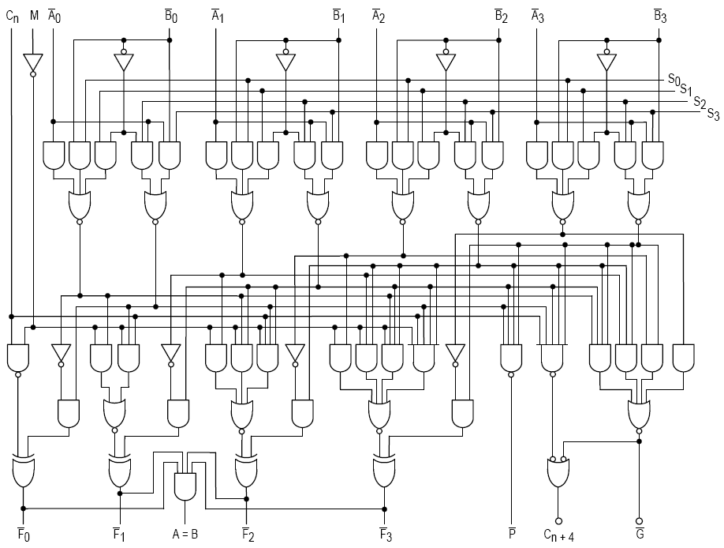
Stolen from Wikipedia
Notes:
74181 schematic, taken from Wikipedia: https://en.wikipedia.org/wiki/Arithmetic_logic_unit#/media/File:74181aluschematic.png

Slide 7
The 74181 ALU
The 74181 is the first ALU built as its own chip. It replaces independent circuits for each command.
This made it much cheaper and faster!
It is a 4-bit ALU, but since it produces a carry on an add, you could combine multiple ones next to each other to do 8-bit, 32-bit, 64-bit, etc. math.
Nowadays, ALUs are integrated onto the CPUs themselves. But they conceptually work the same.

Slide 8
The 74181 ALU Commands
32 total commands, including:
Add / Subtract
Increment / Decrement
AND / NAND
OR / NOR
XOR
Shift (one bit at a time) or more (or ROT) in a loop
Multiply and divide can be done in a loop

Slide 9
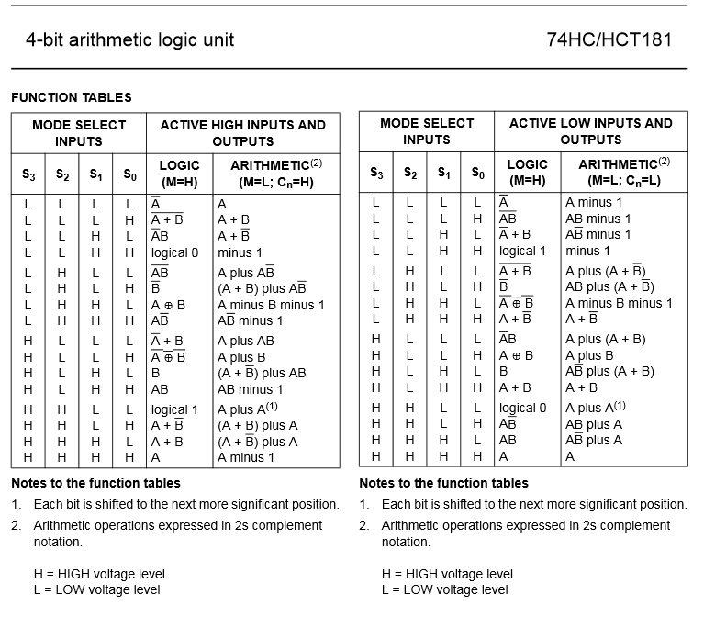
74181 Data Sheet
Notes:
Source: Phillips (http://www.montefiore.ulg.ac.be/~pw/cours/struct-tp/files/74HC_HCT181.pdf)

Slide 10

The 74181 was even in the Wang 2200
Notes:
Source: Wikipedia (https://upload.wikimedia.org/wikipedia/commons/d/db/Wang_System_2200_Computer_1974.jpg)

Slide 11

Superscalar Computing

Slide 12
Superscalar Computing
So when an ALU takes multiple cycles to do a command, it will cause a pipeline stall if you only have one ALU.
For example, on ARM, it can only multiply one pair of bytes per cycle, so doing a 32-bit multiply is 4 cycles.
So the natural next step is to have multiple ALUs.
This is called superscalar computing.

Slide 13
Superscalar Computing
For example, consider the following assembly:
MUL R0, R1, R2
MUL R3,R4,R5
MUL R6,R7,R8
MUL R9,R10,R11
Since these are 32 bit multiplies, if we had only one ALU, our pipeline would stall 75% of the time, until the ALU became available again.

Slide 14
Superscalar Computing
So if we had multiple ALU units, we could dispatch these commands to different functional units, and have them all execute in parallel with each other.
An ALU is a functional unit.
A FPU handles floating point math.
You can also issue load and store commands.
My CPU can be issuing (dispatching) up to 6 instructions per cycle and completing (retiring) up to 4 per cycle. But not all can be the same...

Slide 15
i7-2600K
Sandy Bridge (which dates to 2010) can have up to 100 simultaneous memory operations going at once.
64 assembly instructions can be executing at once

Slide 16
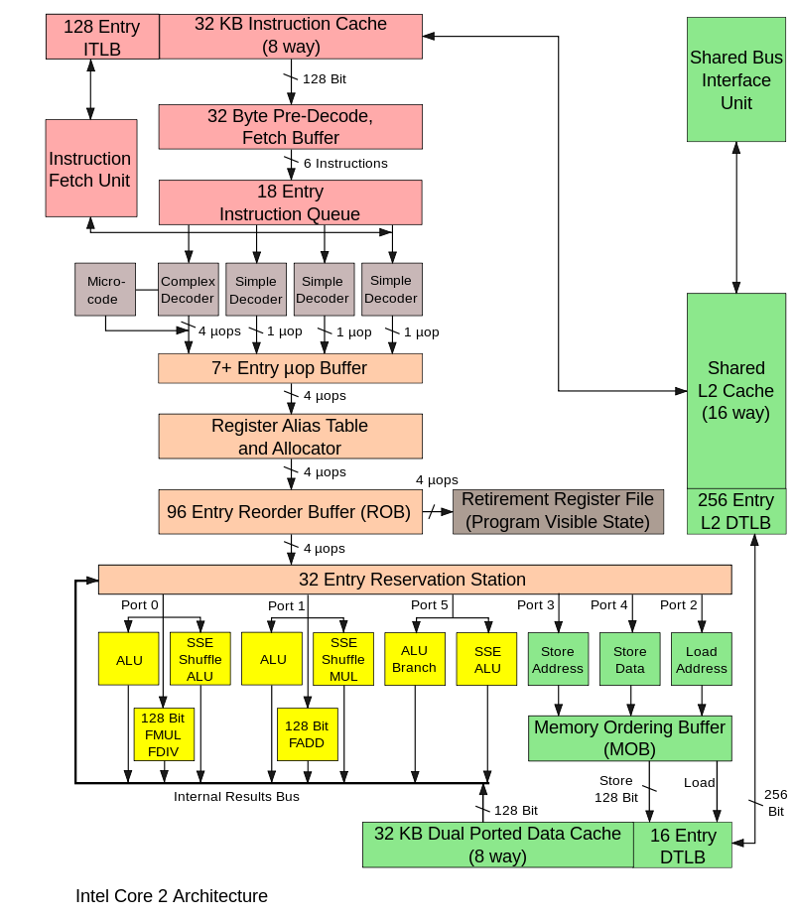

Slide 17
RPi Superscalar
Our Pis can issue two instructions per cycle. So the maximum throughput of our 900Mhz CPU is 1800 million instructions per second (1800 MIPS).
You can get even more performance by doing bitpacking: use shifts and bit masks to put multiple values into the same 32 bit register, then you get much more performance.

Slide 18
Bitpacking
Imagine if I wanted to add two vectors together.
Add {1,2,3,4} repeatedly with to {1,1,1,1}
Will get {2,3,4,5}, then {3,4,5,6}...
I can easily hold these numbers in 8-bit numbers, so I can use the first 8 bits of a 32 bit number to hold the first number, the second the second, and so forth.
Then when I add the two bitpacked registers together, I get four additions for the price of one!

Slide 19
Bitpacking
MOV R0, #1, LSL #24 //Store 1 in the top byte
MOV R1, #2, LSL #16 //Store 2 in a second byte
MOV R2, #3, LSL #8 //Store 3 in a third byte
MOV R3, #4, LSL #0 //Store 4 in a fourth byte
ORR R0, R0, R1 //Add the second byte to top byte
ORR R0, R0, R2 //Add in the third byte...
ORR R0, R0, R3 // And form Voltron.

Slide 20
Bitpacking
We’ll do the same thing for the other vector.
So if R0 holds our first vector and R5 holds our second vector, we can just do a normal addition:
ADD R0, R0, R5 //Four for the price of one!
As long as we don’t overflow of course, so be careful the numbers are going to be well in range.

Slide 21
Bitpacking in Homework #4
So you will be required to do bitpacking in your homework assignment to speed up your for loops.
This is a very common optimization in the ASM world.
Consider the following for loop:
for (int i = 0; i < 1000; i++) { ... }
It’s a waste of three 32 bit registers to hold i, #1000, and the +1 separately.
They could all be held in one register.

Slide 22
Bitpacking in Homework #4
Imagine if R0’s left 16 bits held the current counter (it holds “i”), and the right 16 bits holds the step size (1).
R1 holds the threshold (1000).
Then we could do a loop step by doing this:
ADD R0,R0, LSL #16
If we want to see if we’ve finished:
CMP R1, R0, LSR #16

Slide 23
Bitpacking in Homework #4
If you think about it a bit, you should be able to figure out how to get rid of the need for R1 as well.

